Slide 1


Slide 2
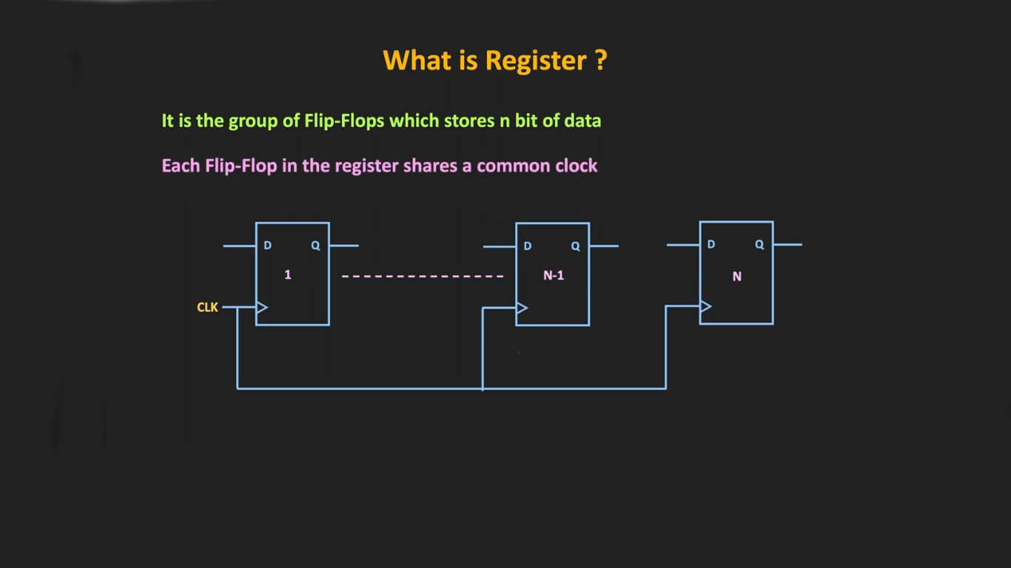
A shift register is a digital memory circuit found in calculators, computers, and data-processing systems. Bits (binary digits) enter the shift register at one end and emerge from the other end. The two ends are called left and right.

Slide 3
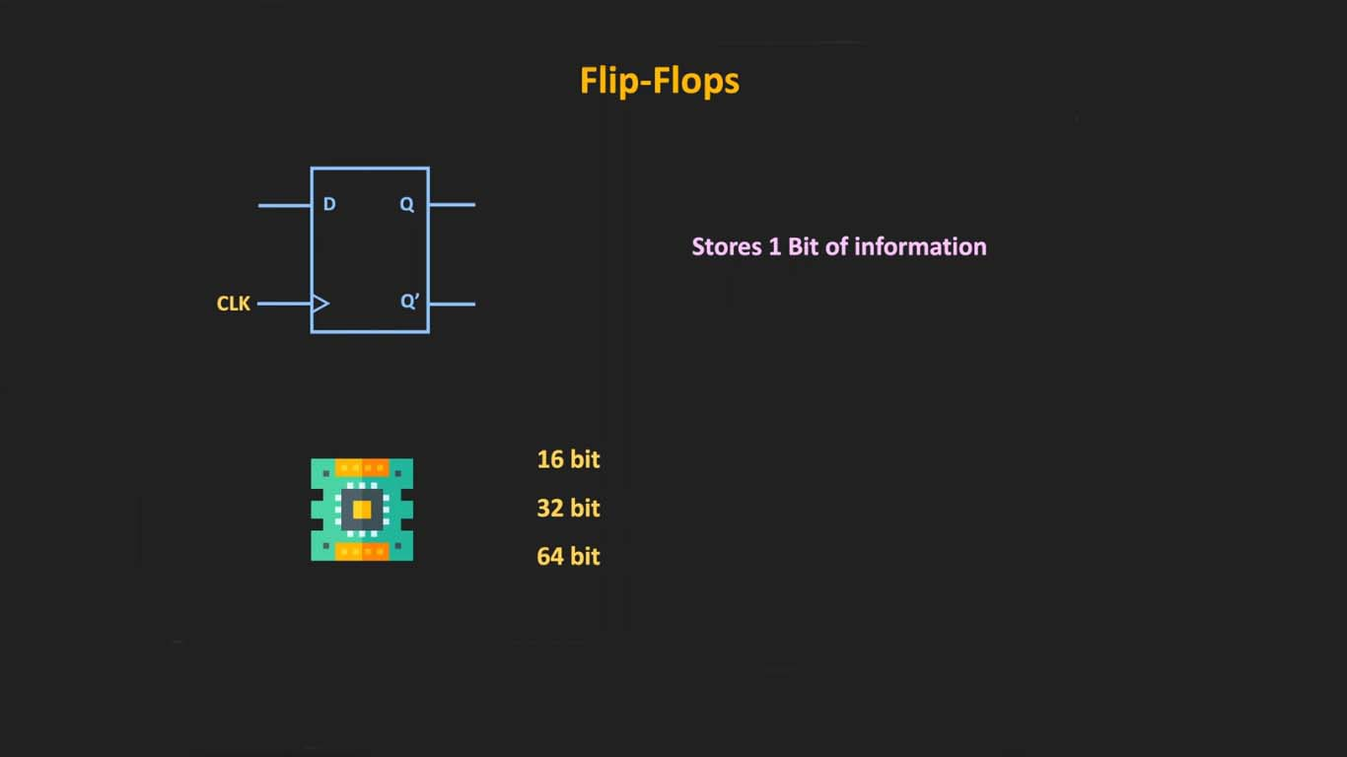
Shift registers are commonly used in converters that translate parallel data to serial data, or vice-versa. Shift registers can also function as delay circuits and digital pulse extenders

Slide 4
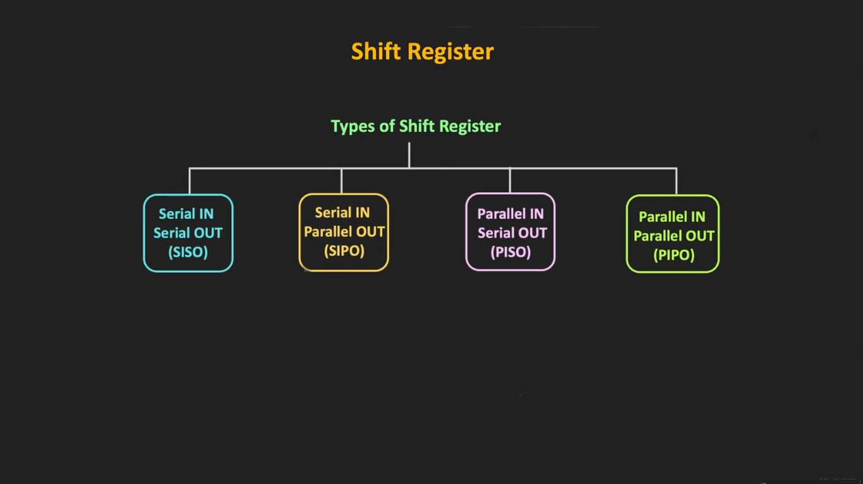

Slide 5
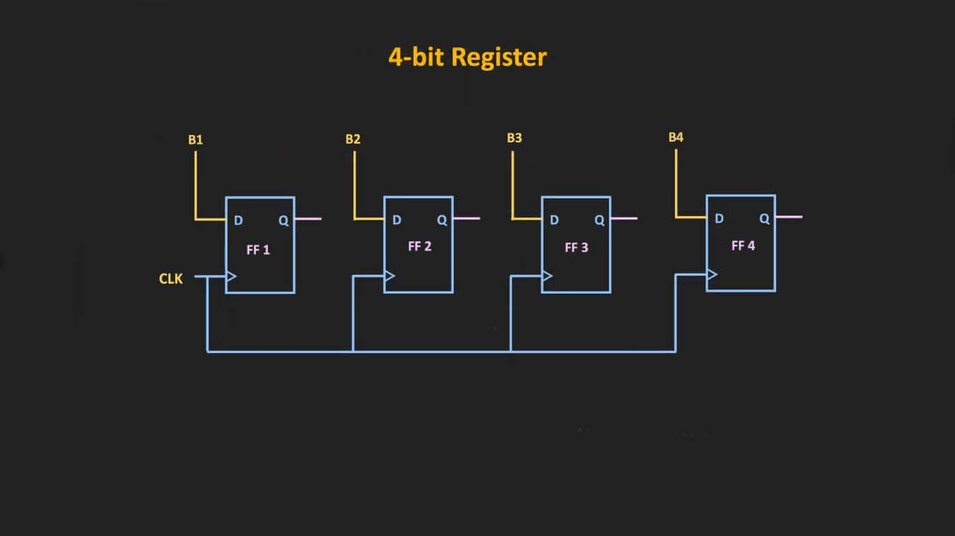

Slide 6
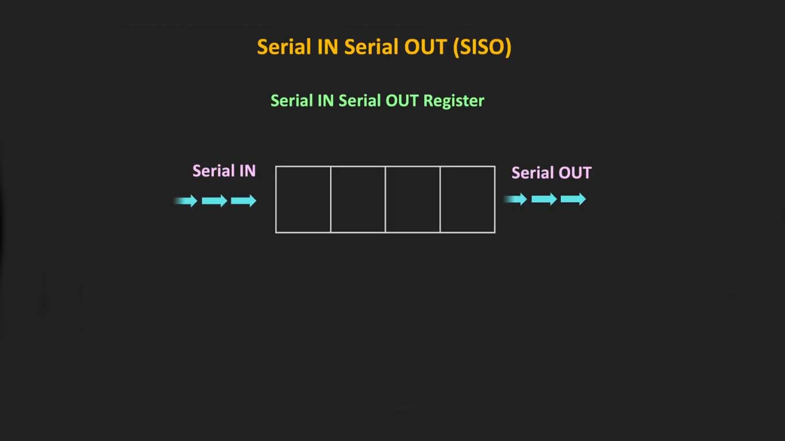
Serial In Serial Out (SISO) shift registers are a kind of shift registers where both data loading as well as data retrieval to/from the shift register occurs in serial-mode

Slide 7
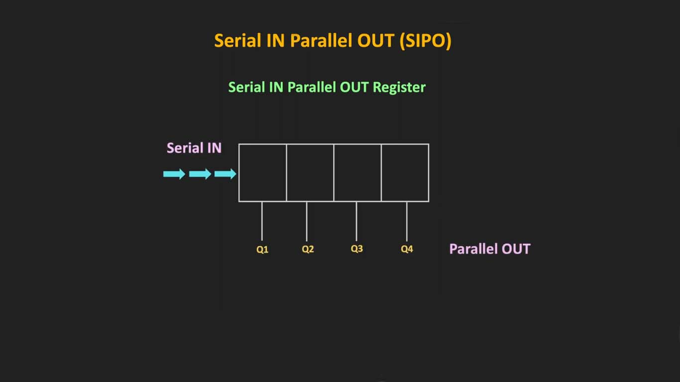
The register is loaded with serial data, one bit at a time, with the stored data being available at the output in parallel form.

Slide 8
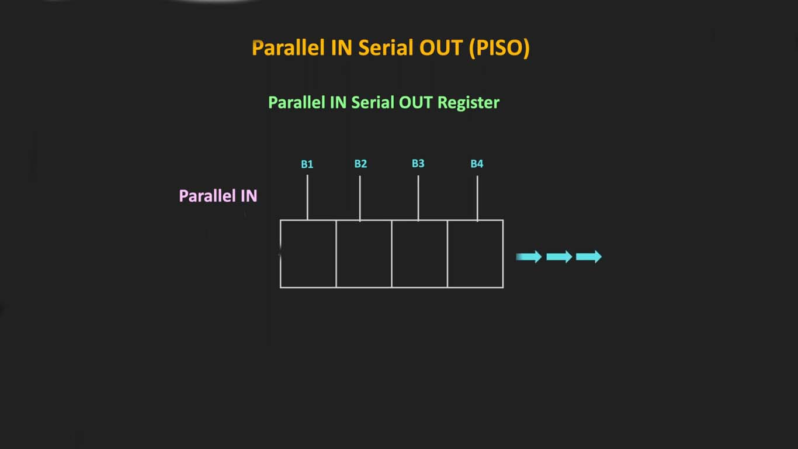
The parallel data is loaded into the register simultaneously and is shifted out of the register serially one bit at a time under clock control.

Slide 9
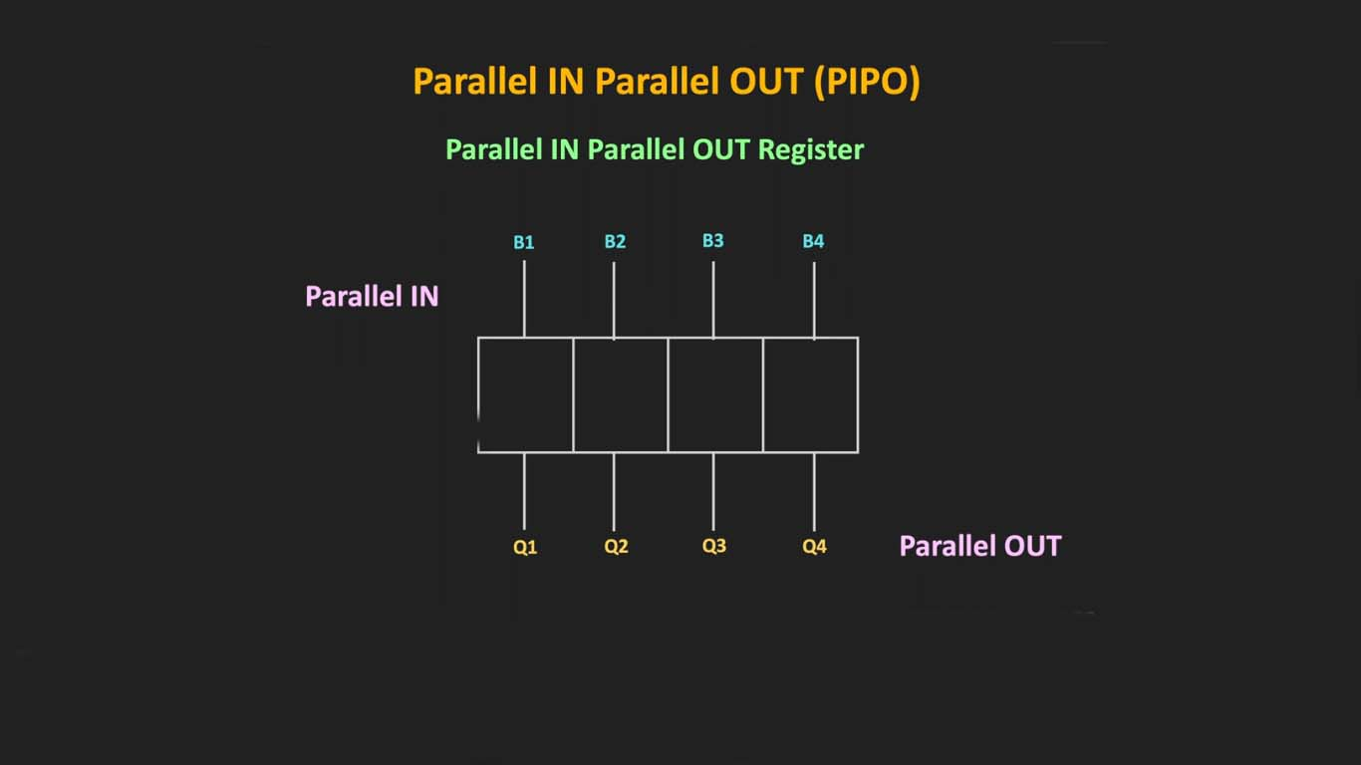
The parallel data is loaded simultaneously into the register, and transferred together to their respective outputs by the same clock pulse.

Slide 10
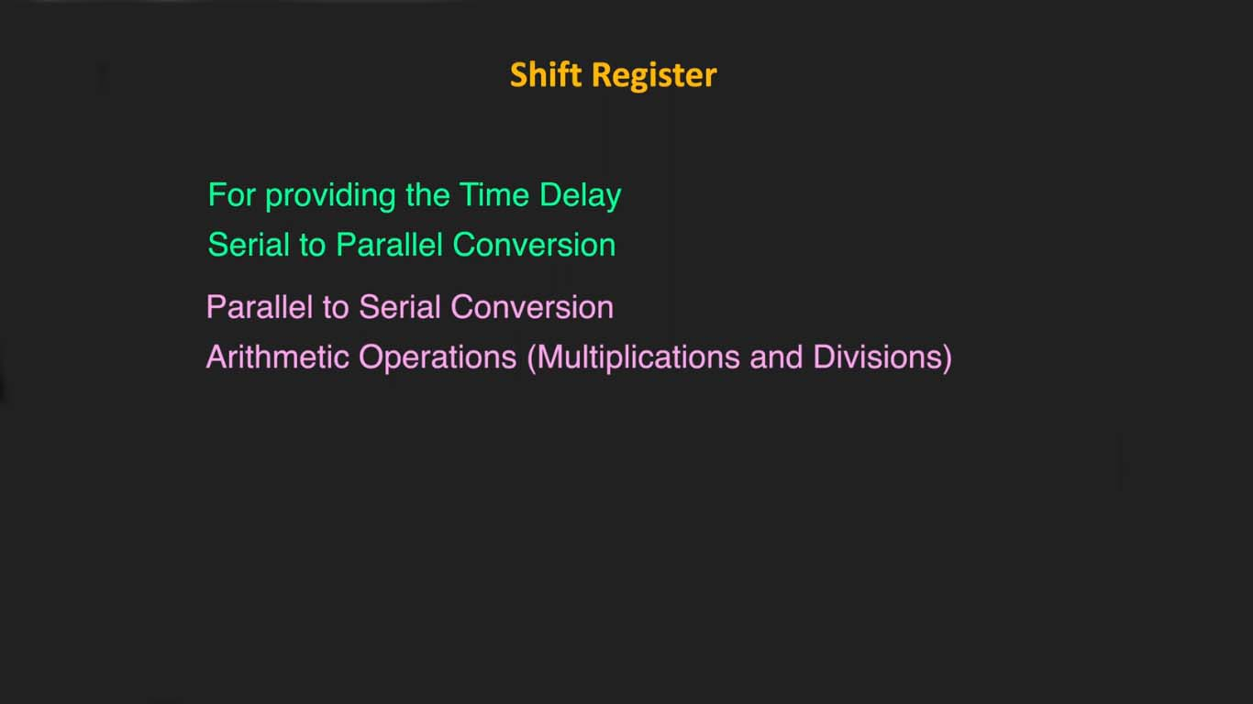

Slide 11
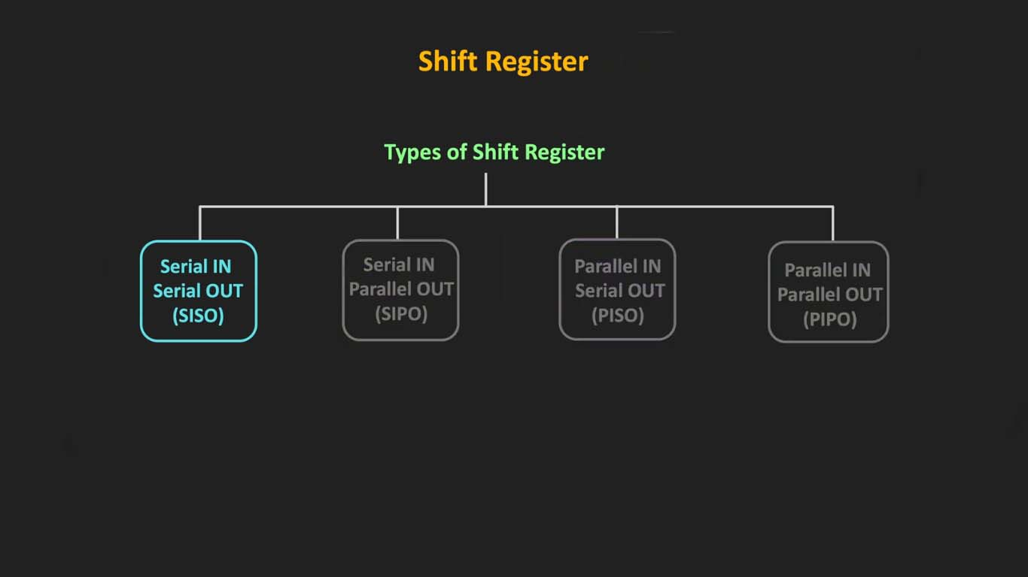

Slide 12
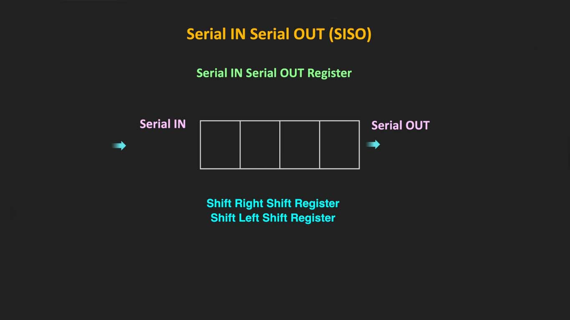

Slide 13
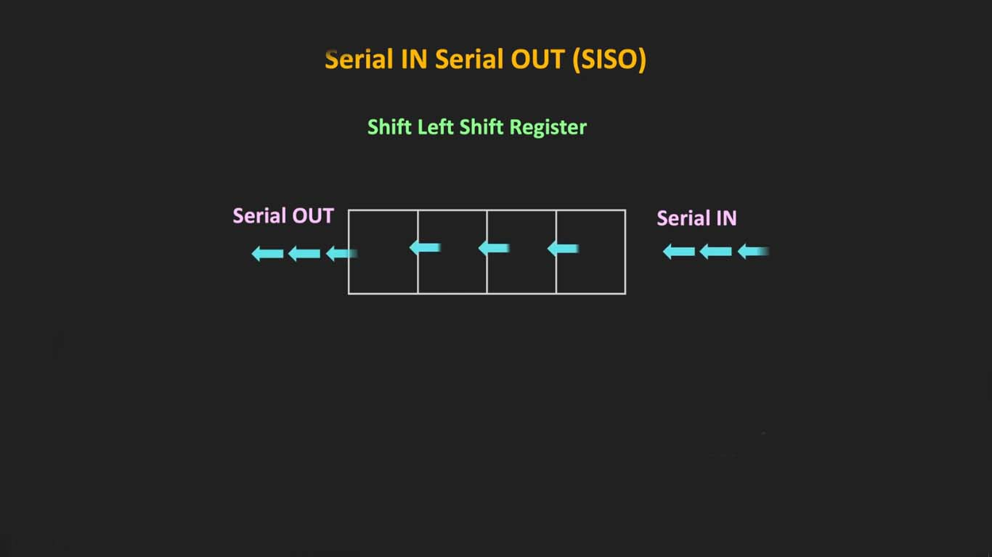

Slide 14
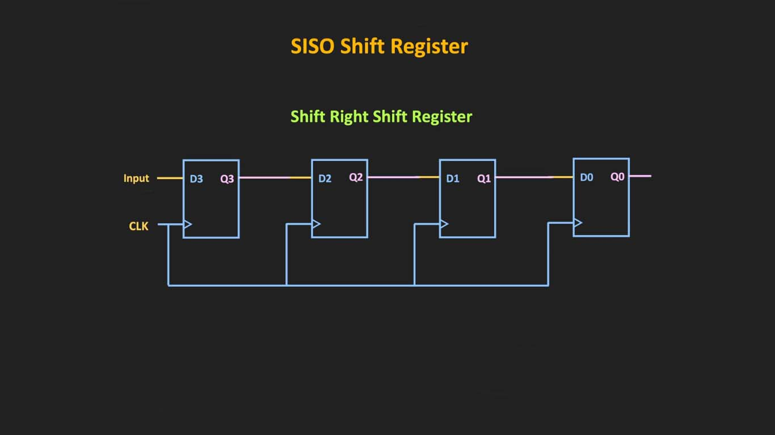

Slide 15
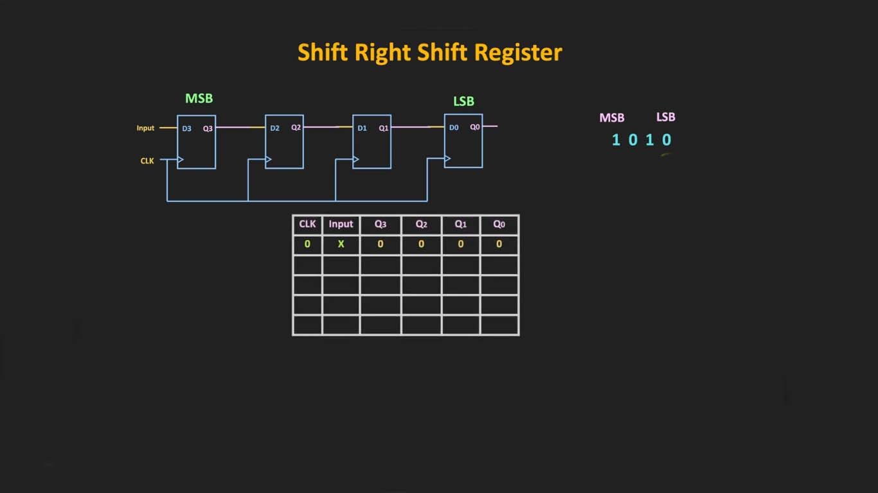

Slide 16
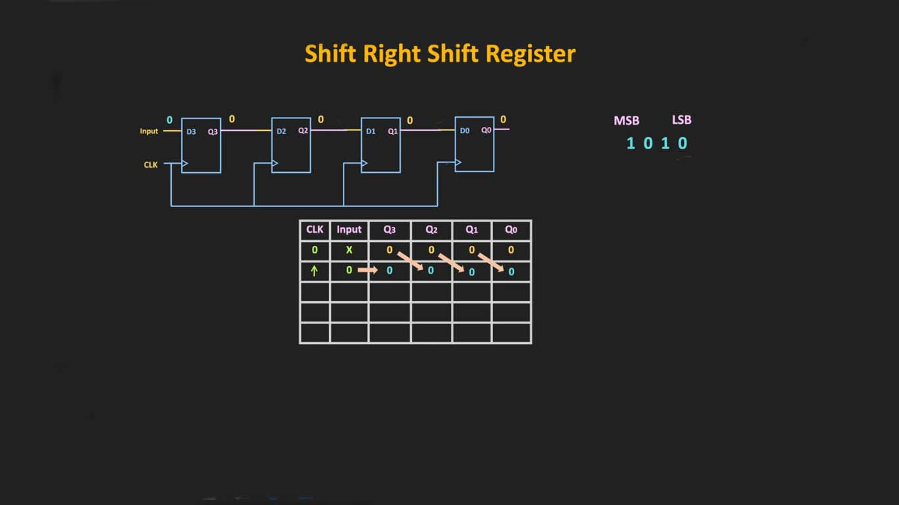

Slide 17
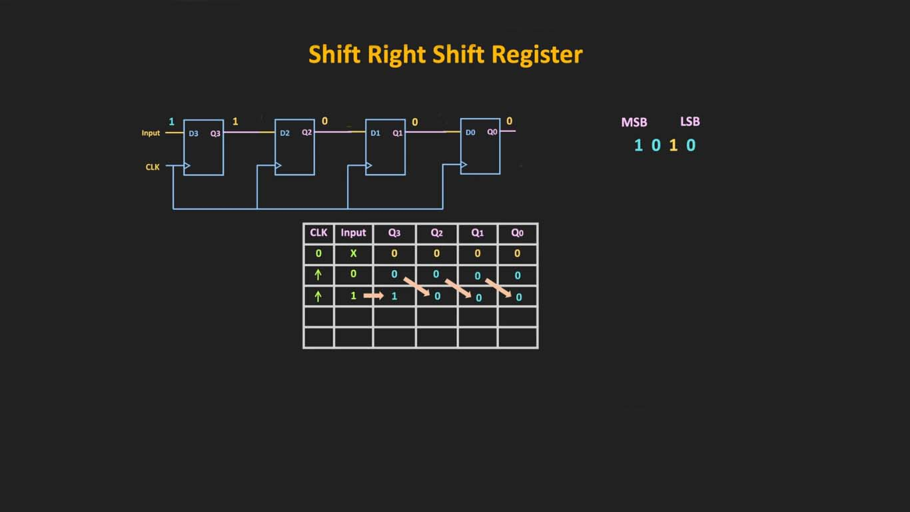

Slide 18
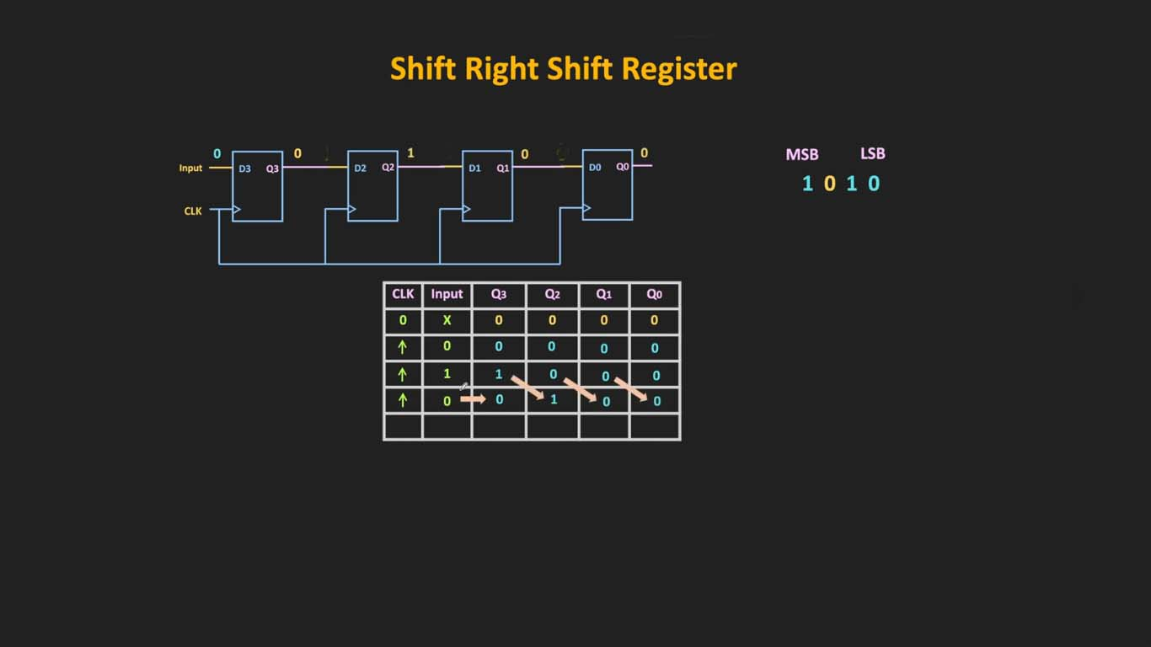

Slide 19
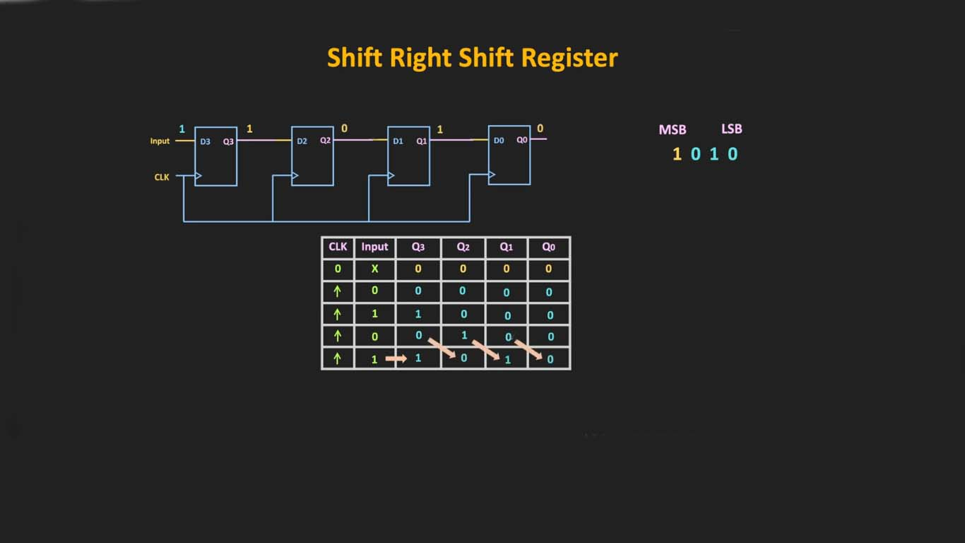

Slide 20
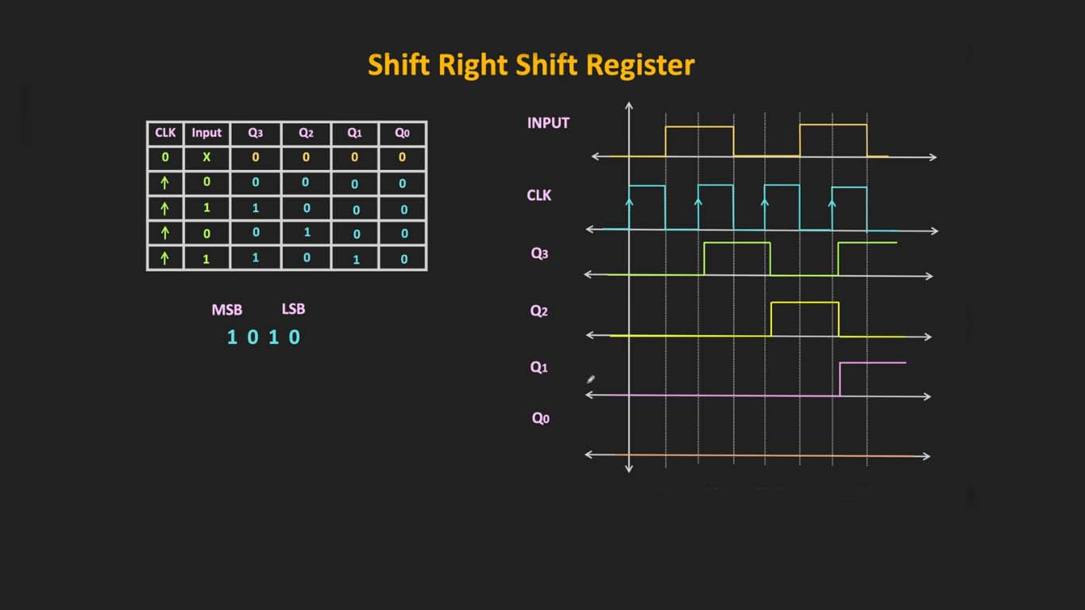

Slide 21
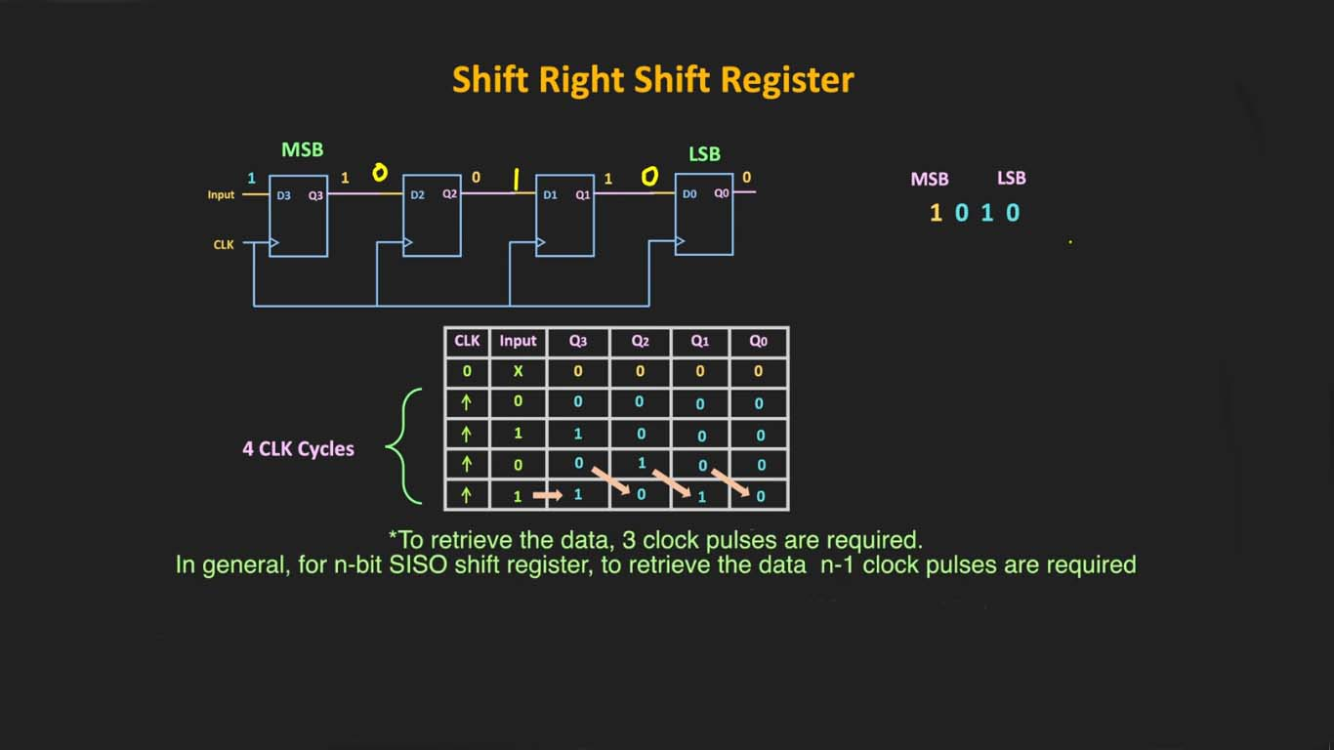

Slide 22
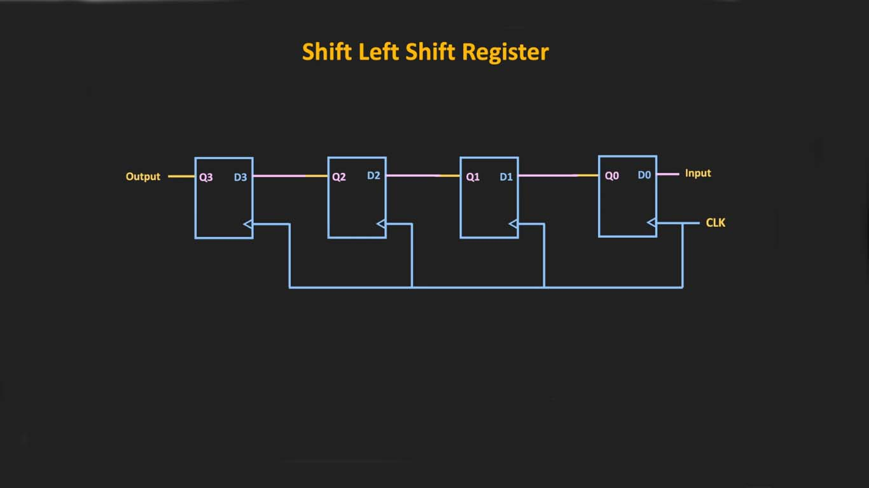

Slide 23
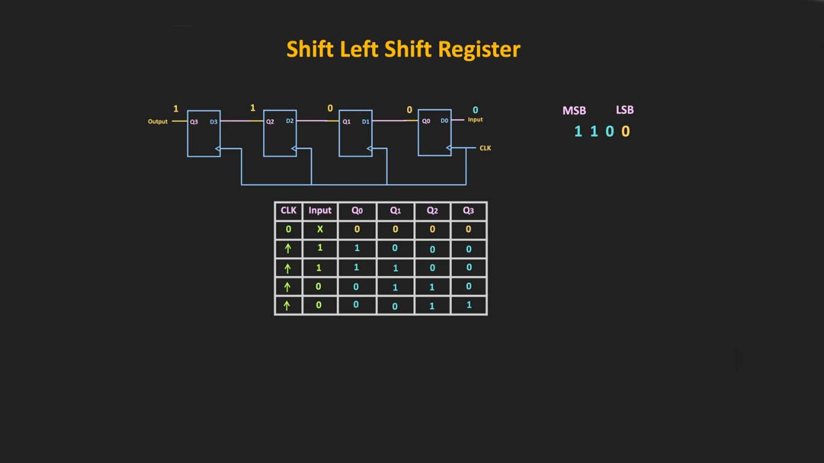

Slide 24
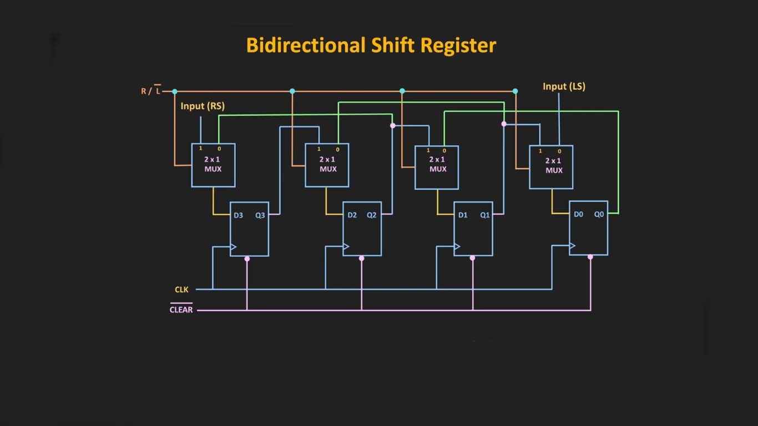
Bidirectional shift registers are the storage devices capable of shifting the data either right or left, depending on the mode selected
R/L control line is made either low or high to opt for either left-shift or right-shift of the data bits, respectively.

Slide 25
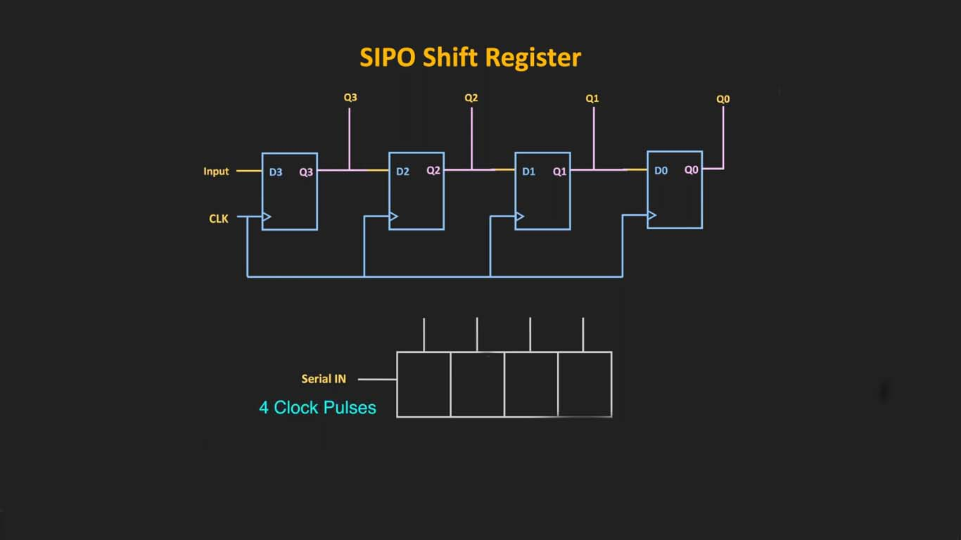
The register is loaded with serial data, one bit at a time, with the stored data being available at the output in parallel form.

Slide 26
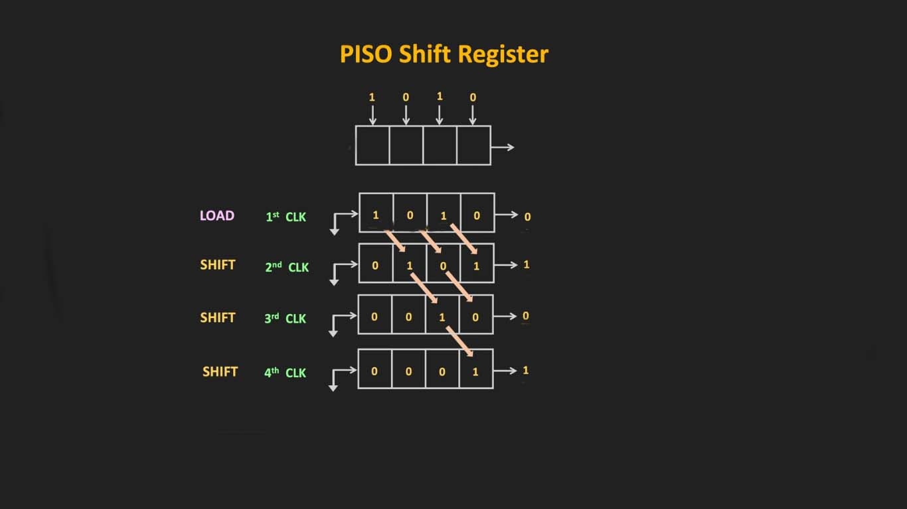

Slide 27
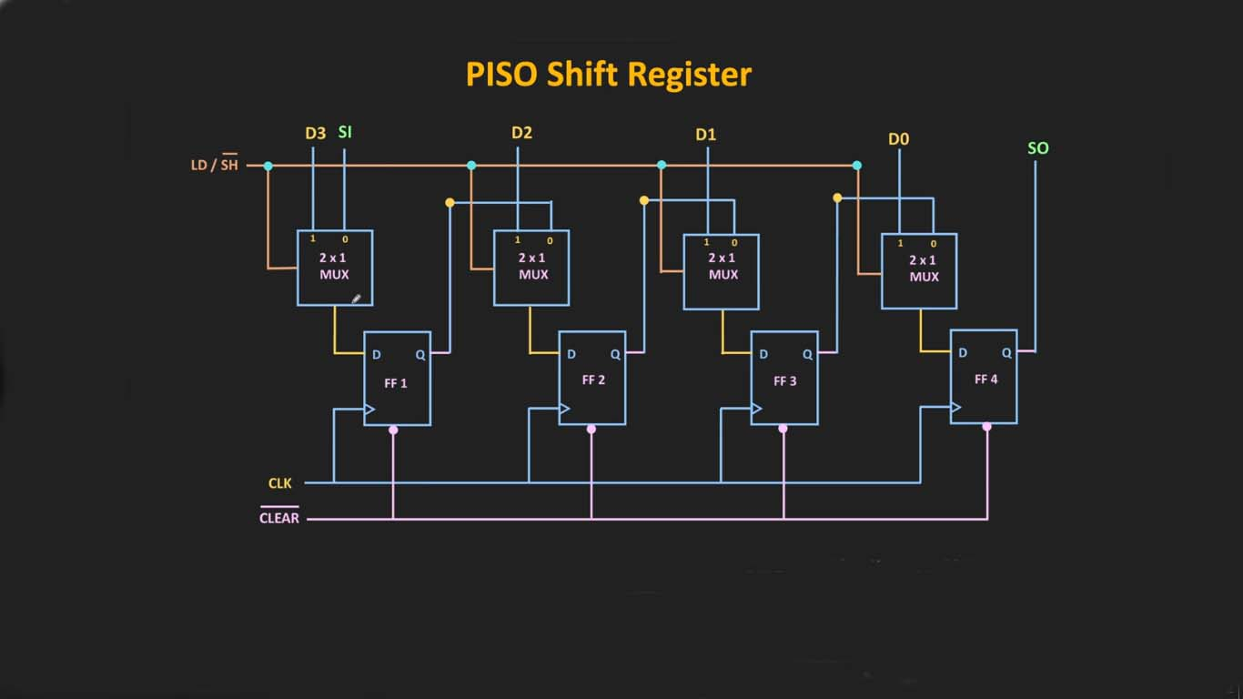

Slide 28
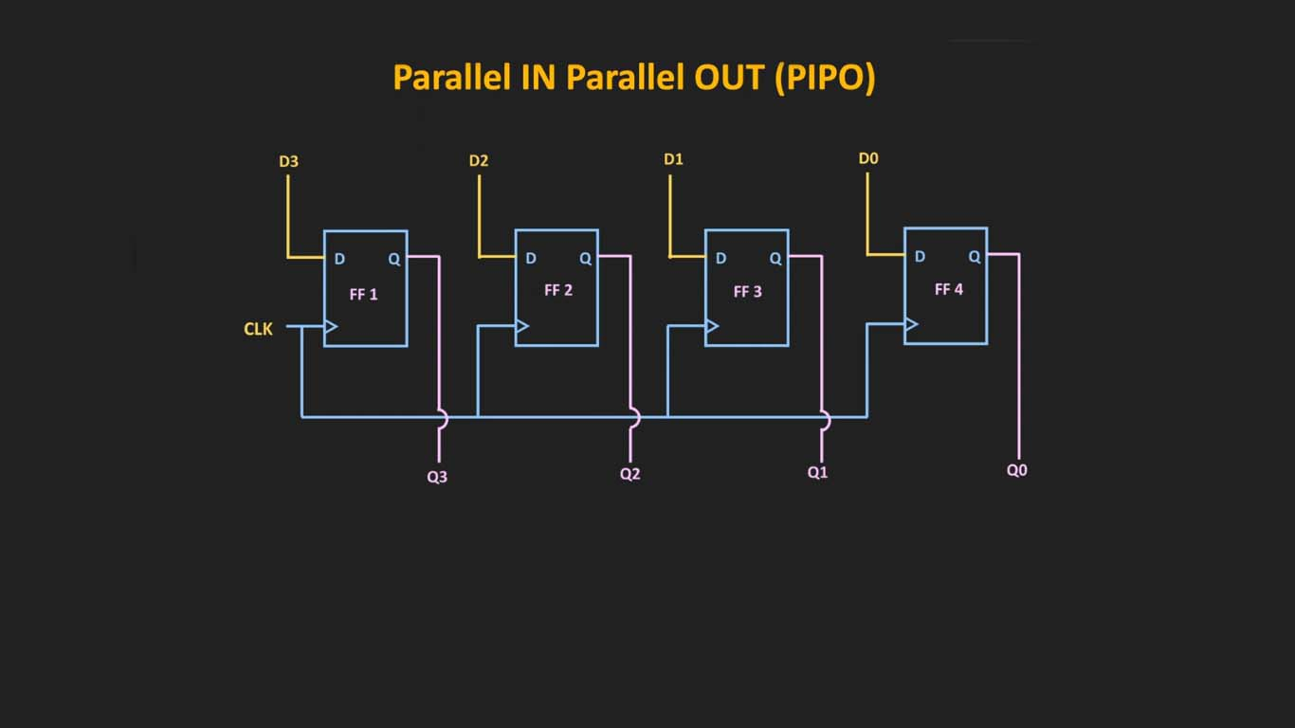
This is a way to convert data from a parallel format to a serial format. By parallel format we mean that the data bits are present simultaneously on individual wires, one for each data bit as shown below.
By serial format we mean that the data bits are presented sequentially in time on a single wire or circuit as in the case of the “data out” on the block diagram below.

Slide 29

Application of Shift Registers
Shift register is used as Parallel to serial converter, which converts the parallel data into serial data.
It is utilized at the transmitter section after Analog to Digital Converter ADCADC block.
Shift register is used as Serial to parallel converter, which converts the serial data into parallel data.
It is utilized at the receiver section before Digital to Analog Converter DACDAC block.
Shift register along with some additional gates generate the sequence of zeros and ones. Hence, it is used as sequence generator.
Shift registers are also used as counters. There are two types of counters based on the type of output
from right most D flip-flop is connected to the serial input.

Slide 30
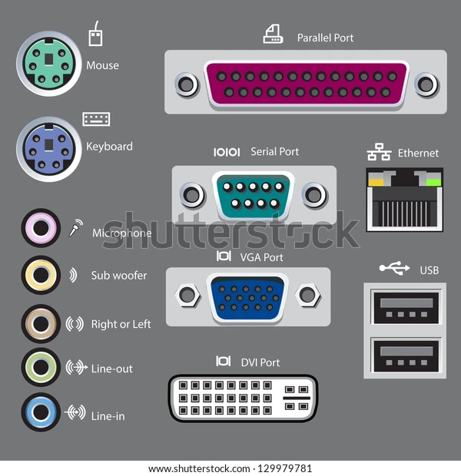
Application of Shift Registers

Slide 31
